Slide 1


UWA DATA ANALYSIS BOOTCAMP - PROJECT 2 ETL TEAM 6 proposal
Our Team
Johan Snyman
Jon Wood
Our Git Repository
https://github.com/jonowood/Project_2

Slide 2
Project 2-Etl : FINANCE/SOCIAL SERVICES How does average weekly earnings influence Estimated residence Population The aim of our project is to uncover patterns in POPULATION MOVEMENTS AND AVERGE INCOME CHANGES . We’ll examine relationships between POPULATION CHANGE and AVERAGE INCOME, PERCENTAGE CHANGE and other related relationships derived from the data.
Data Sources
Review
Inspect
Simulate
E
T
L
Activities
Extract
Transform
Load
Locate and download data
ABS – AWE.CSV 27K datapoints
ABS – ERP.CSV 7,5K datapoints
Prework, structure, common keys, duplicates and NAN
Data formats
Design ERD flow for desired table elements
Create POSTGRES Tables
Load .CSV to Python and convert
Check CSV loaded correctly
Wrangling steps
Cleaning – NAN
Align Time/reasons
Rename headers
Remove columns
Join
Connect to PostGres
Load Data
Check and test data

Slide 3
transform
extract
Data Sets
Datasets Sourced From - https://explore.data.abs.gov.au/ (Licence CC01)
File A - ABS – AWE.CSV (27K datapoints) - Population Movement Data for Australia
File B - ABS – ERP.CSV 7,5K (datapoints) – Average Income Data for Australia
Initial Findings
Both data sets will require filtering of data based off multiple columns. The data is in a similar format across both sets.
Data is incomplete and will require the filling of NaN values. Some column values will require extra characters removed prior to transforming.
For loading this data to Postgres in a relational database, we will need to explode the data into multiple tables and link with date and location ID’s.
REQUIRED STEPS TO TRANSFORM DATA;
File A - ABS – AWE.CSV (27K datapoints)
Filter column C values to only include ‘Earnings’
Filter column B to only include 'All employees average weekly earnings’
Filter column G to only include ‘Original’
Copy columns to DataFrame - REGION: Region, TIME_PERIOD: Time Period, OBS_VALUE
File B - ABS – ERP.CSV 7,5K (datapoints)
Filter column B to only include ‘4: Internal Arrivals’, ‘5: Internal Departures’, ‘6: Net Internal Migration’, ‘13: Change Over Previous Quarter’
Copy columns to DataFrame - REGION: Region, TIME_PERIOD: Time Period, OBS_VALUE
Additional Pandas Transformations – Data Filtering, Data Mapping, Data Deduplication, Derived Variables

Slide 4
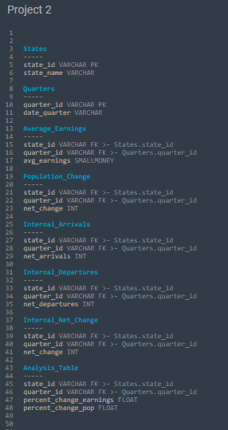
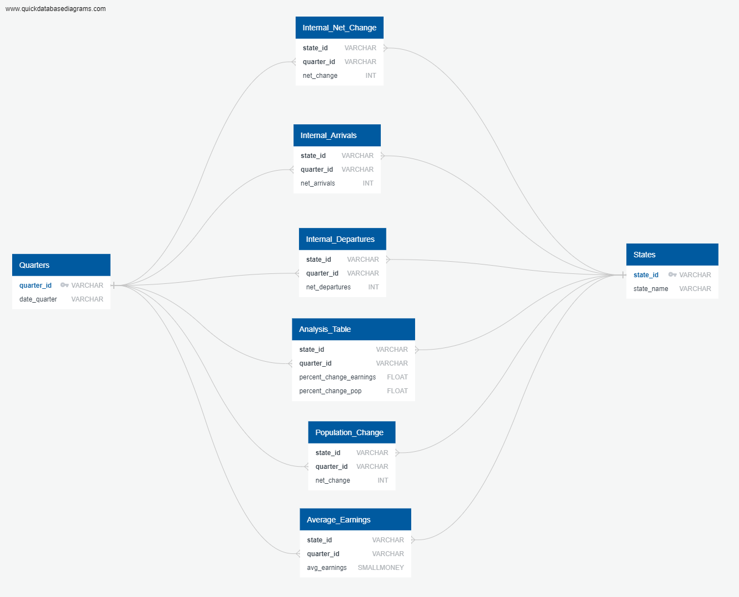

load
Relational Database - We will create a Database and Schema in PostgreSQL then Load the data for future Analysis

